Slide 1

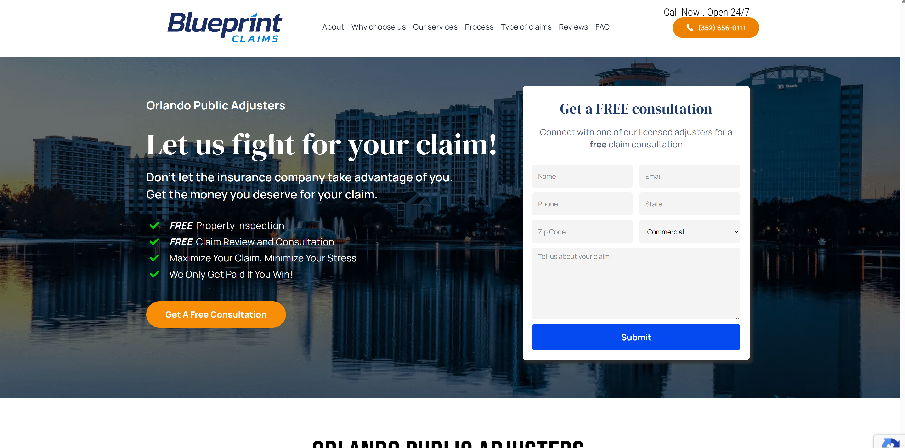

Landing page/home
Call 8AM-5PM, text anytime
Magnum PA
615-295-1088
Serving all of Florida
Get the settlement you deserve
Don't wait until it's too late. The sooner we get involved, the better we can protect your interests. Contact us today for a free, no-obligation review of your damage and your policy.
Professional estimates
Only pay if you get paid
Full Service Public Adjuster
Notes:
I like the free consultation. Can we add the image in slide 2 as the background? The website for this one is: https://fightforyourclaim.com/
Can we include the FAPIA logo somewhere on all pages? Can we include a review us on Google link on the pages? https://g.page/r/CWufBejxRYG5EAE/review

Slide 2

Background pic for slide 1, landing page

Slide 3
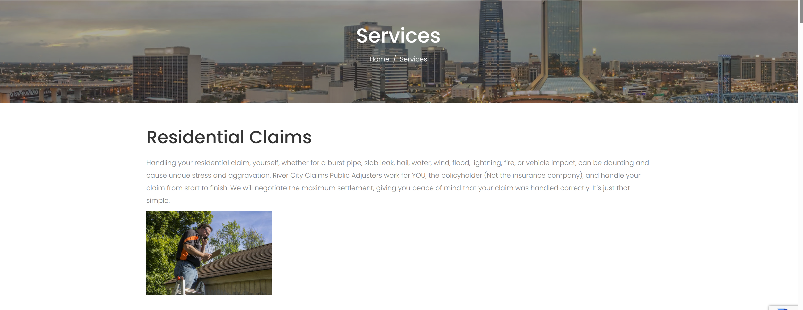
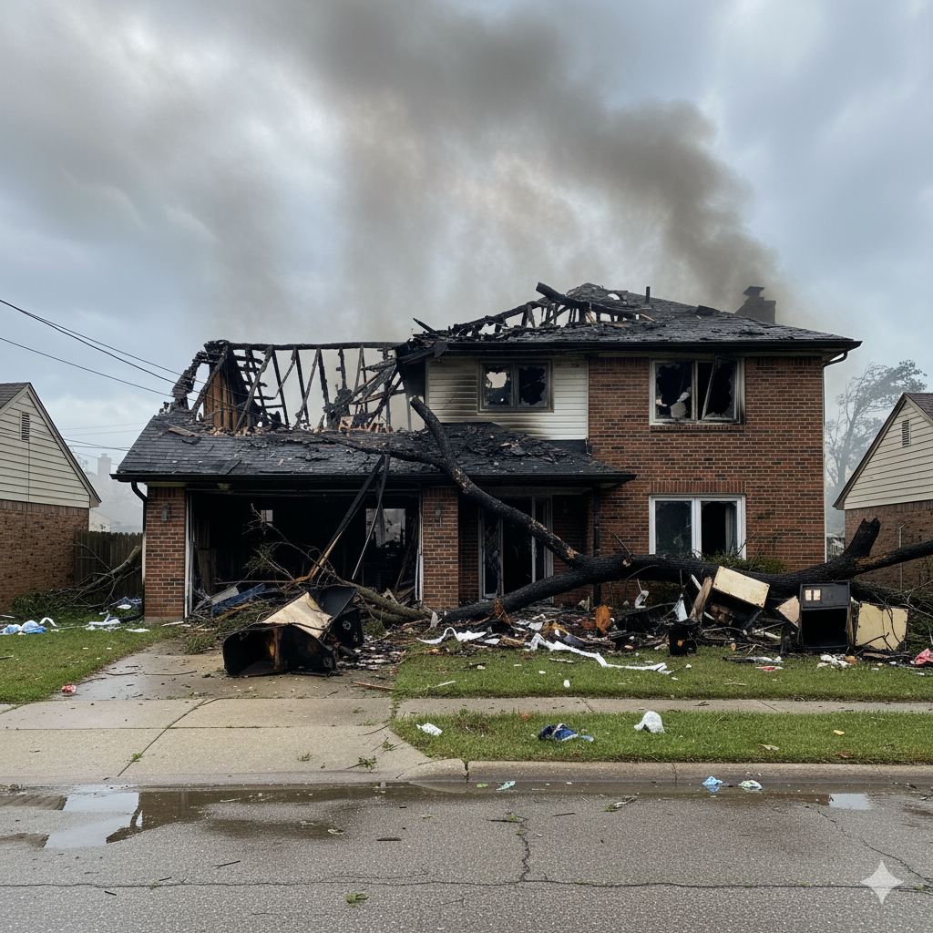
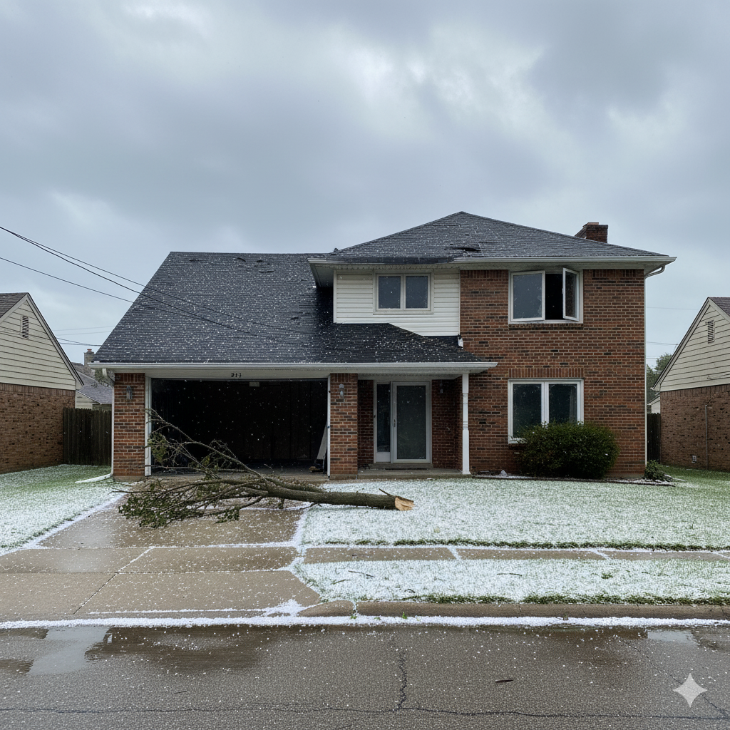
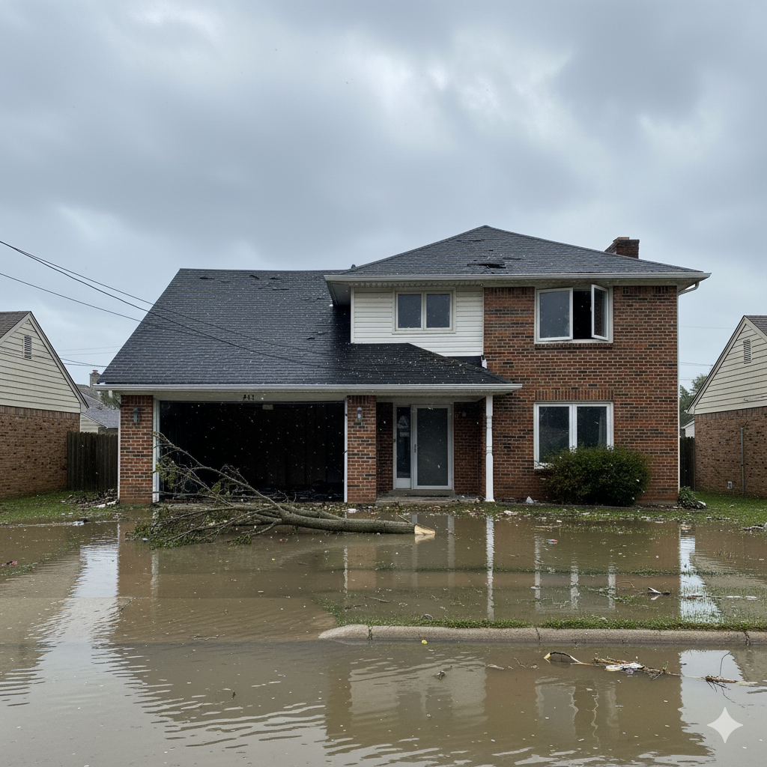

Notes:
I like the way this looks for services. https://www.rivercityclaims.com/services/
Can we put the picture from slide 2 in the background instead of the city?

Slide 4
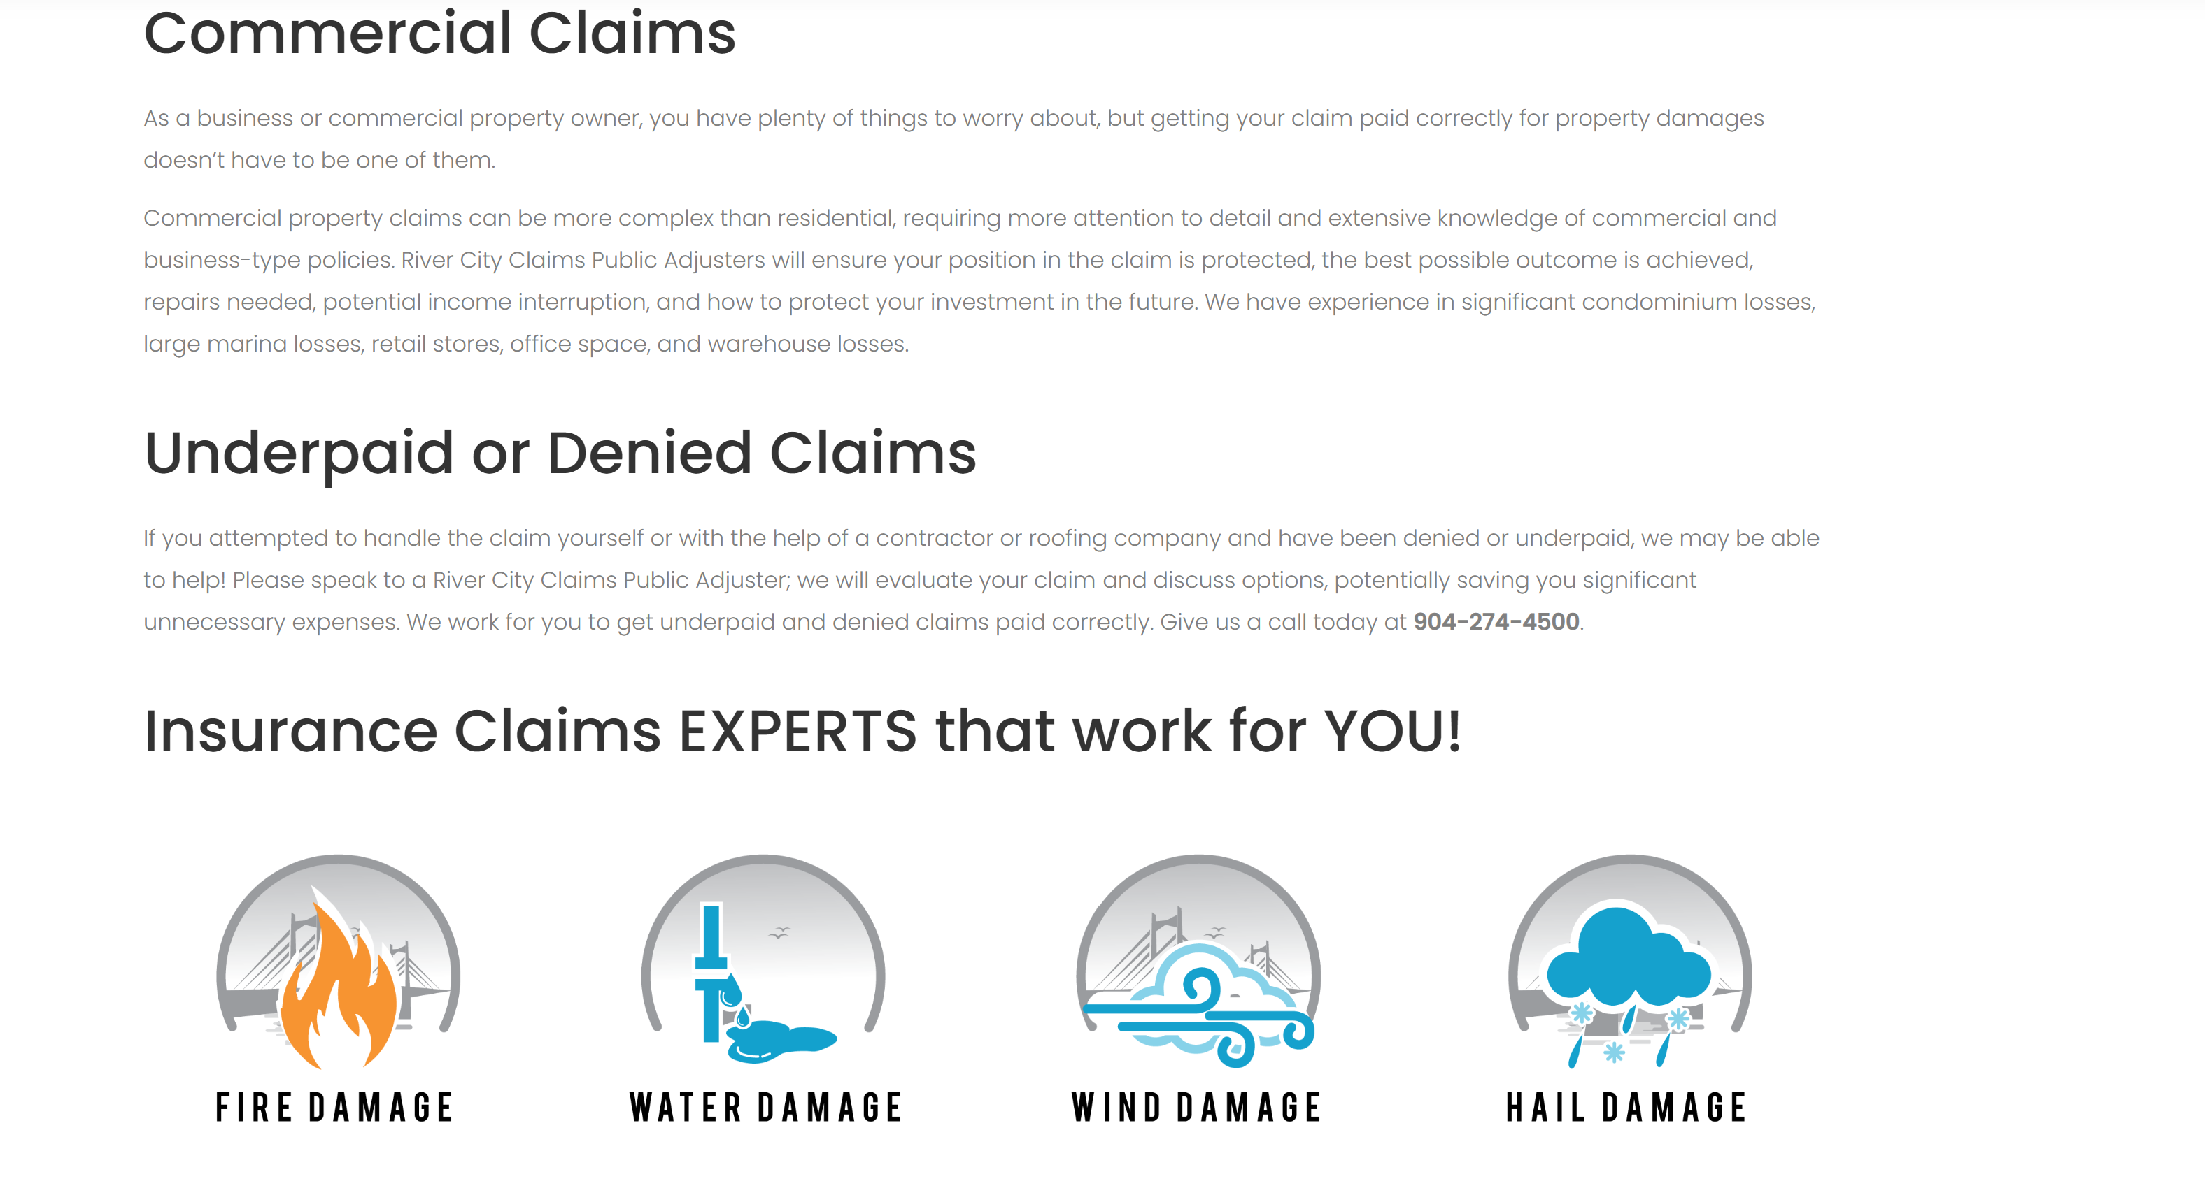
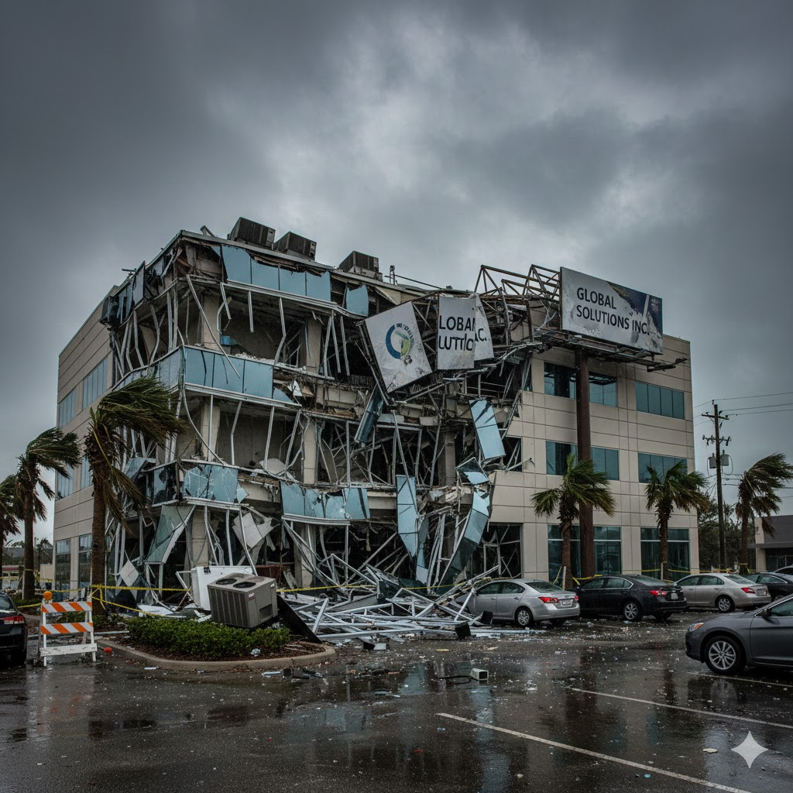


If your claim has been denied, or you don’t have enough money to get the work done, give us a call to get an honest opinion of your claim’s value and expected results should you decide to hire us.
Notes:
Under denied claims, but before the claim type icons, can we add a new section that says the following? DIY We can provide a professional inspection and estimate with detailed photos of your damage, so you can deal with the insurance company on your own. We don’t recommend this approach, but America is all about freedom, right? Contact us for fee schedules based on your claim complexity today!

Slide 5
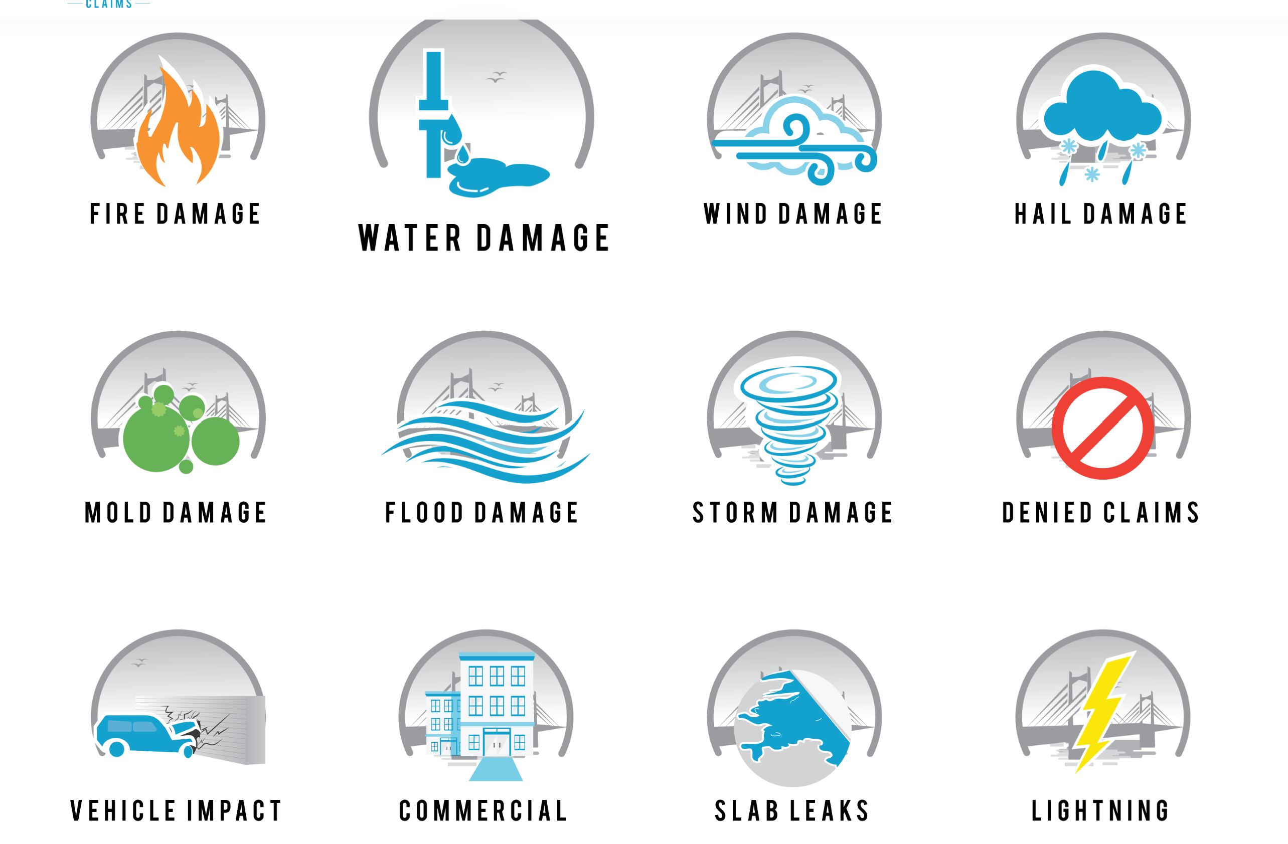
Notes:
I like how these icons are interactive. Can you modify them a bit so we’re not stealing the content, or do I need to do that? Can we add underpaid claims with a house half fixed, and auto claims instead of vehicle impact?

Slide 6
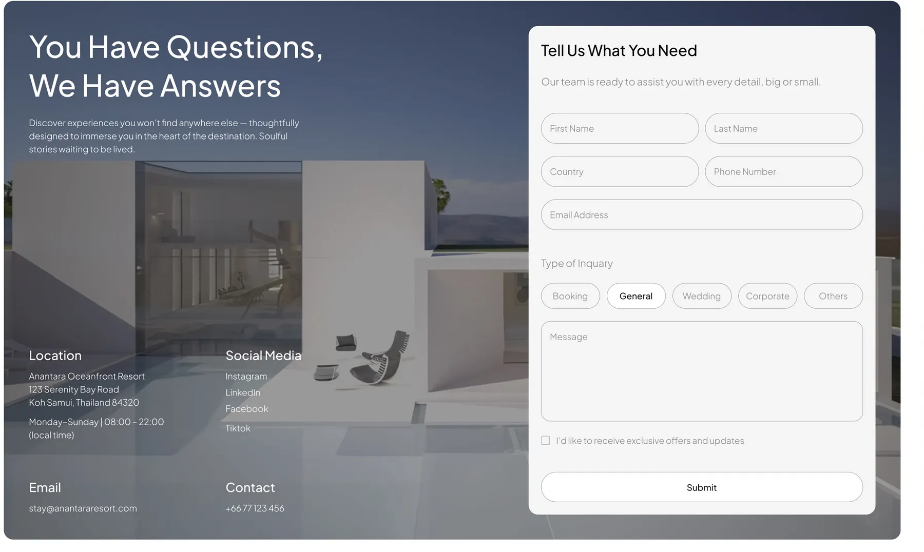






Contact us
Notes:
Can we do something similar to this for the contact us page and generate a QR code for it? We don’t need the country box from the top of the contact form. Type of inquiry can be type of claim (residential, commercial, auto, diy). Can we remove the checkbox and include language on all the contact forms that says “By clicking submit, I agree to be contacted by Magnum PA for marketing purposes through methods email, calls, and text messages using the information provided. Magnum PA will never sell my information to any third party and I can opt out of being contacted at any time”
Can we remove location?
Here is all my social Media:
Facebook: https://www.facebook.com/profile.php?id=61574631652656
Instagram: https://www.instagram.com/adjustlyphe?fbclid=IwY2xjawMPJbhleHRuA2FlbQIxMABicmlkETFDZXZOZDdNU21XRUFWQURkAR7K947Tg94QBSSCYHXVcDriCWrqAgJ6sSVKDat3g5-ybfvRSZntC8e6Wh4HcQ_aem_VFwsjei9E7_JqAlf7VsJbw
Threads: https://www.threads.com/@adjustlyphe?xmt=AQF0i7ZGMe-9vqTKh_NJVxbC7E-aYlgd9gWS61W15UM3KaY
X: https://x.com/AdjustLyphe
Bluesky: https://bsky.app/profile/adjustlyphe.bsky.social
Mastodon: https://mastodon.social/@adjustlyphe
Tik tok: https://www.tiktok.com/@adjustlyphe

Slide 7
FAQ
How much do you charge? We work on a contingency fee basis, which is a small percentage of the final settlement. If we don't recover money for you, you owe us nothing.
Will hiring a PA slow down my claim? On the contrary, we often expedite the process by providing thorough, professional documentation that speeds up the review process.
Can you help me even if my claim has already been filed or denied? Absolutely. We specialize in taking over claims that have been underpaid, delayed, or outright denied by the insurance company.
Is a Public Adjuster the same as the adjuster the insurance company sends? No. The insurance company's adjuster works for the insurance company. We work for you. We have no financial incentive to minimize your payout.
Notes:
I like this look for FAQs https://fightforyourclaim.com/faqs/

Slide 8
About
Magnum PA was started in 2025 after the primary adjuster, Craig McGonigle, grew sick of working for the insurance company and seeing insureds taken advantage of by insurance companies, and agents selling on price. Insureds would think they were covered, but the fine print in the insurance contract would cause them to be out of pocket more than their deductible. He has been licensed in Florida since 2014.
At Magnum PA, we believe that when disaster strikes, you deserve a fair and complete recovery. Insurance policies are complex, and the system is designed for the insurance company's benefit, not yours. Our mission is to level the playing field. As licensed Public Adjusters, we have the technical expertise and negotiation skills to interpret policies, document every dollar of damage, and vigorously negotiate on your behalf.

